Slide 1

Presented By
Showmya.T

Slide 2
Agenda
ER-Diagram.
Traditional versus Online shopping.
Conclusion.

Slide 3
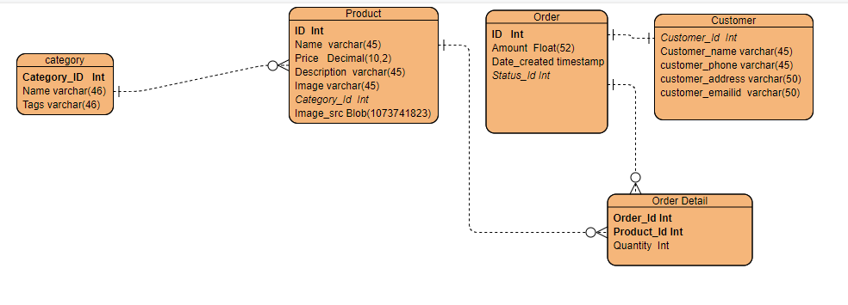
ER-Diagram

Slide 4
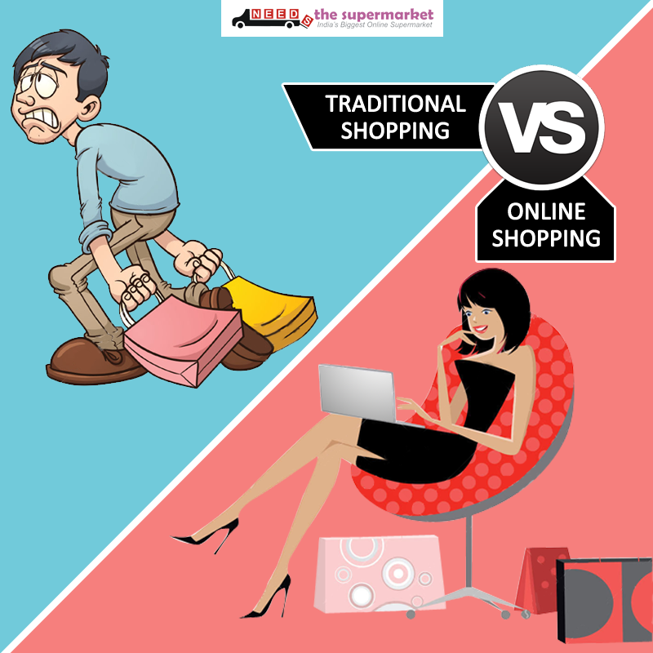

Slide 5

Conclusion
It saves time!
You can compare prices instantly and get the best value.
You can make a better decision using reviews.
It saves energy and cost that would be needed to go to a retail shop.
You get delivery wherever you want.
Easier refund process.
Flexible payment options.

